Slide 1
Recent INFLUX Flight Experiment
Boundary Condition Flight Expt: 2/24/2014

Slide 2
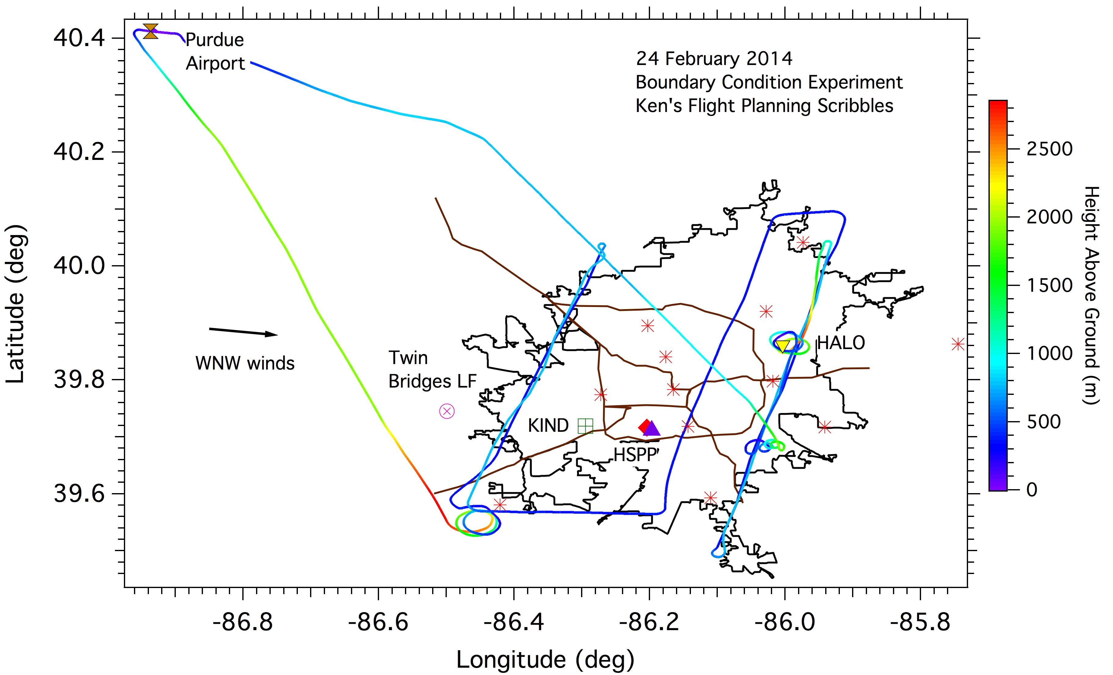
Flight Path 24 Feb 2014
Notes:
Two upwind transects, 2000 ft msl (365 m agl), 3500 ft msl (460 m agl).
2 downwind transects
3 VP’s.

Slide 3
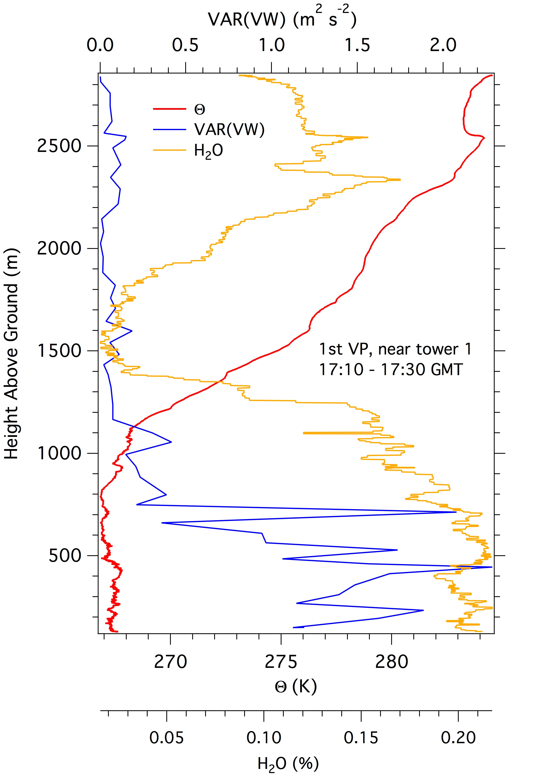
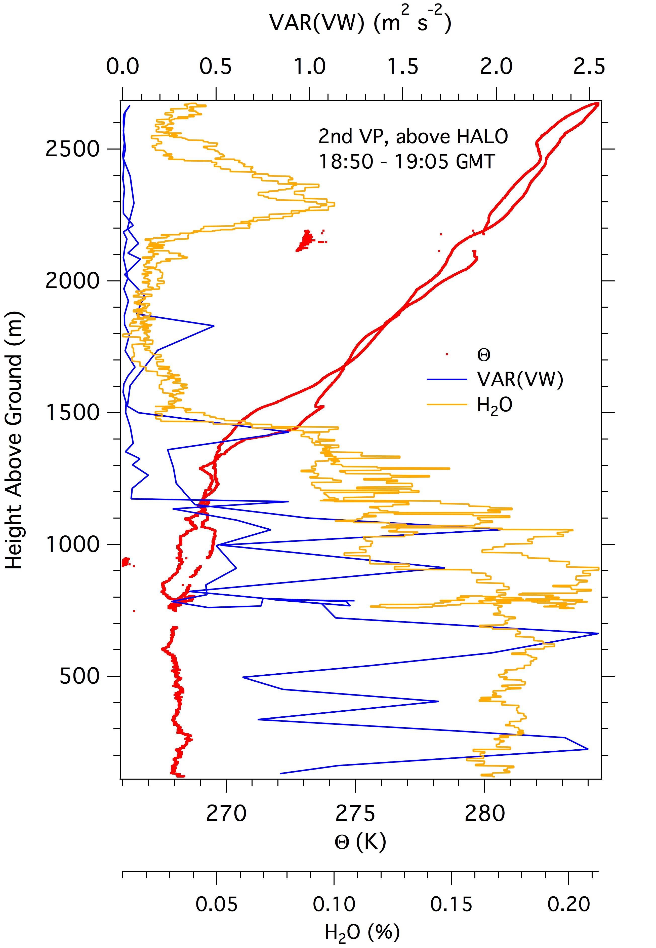

Slide 4
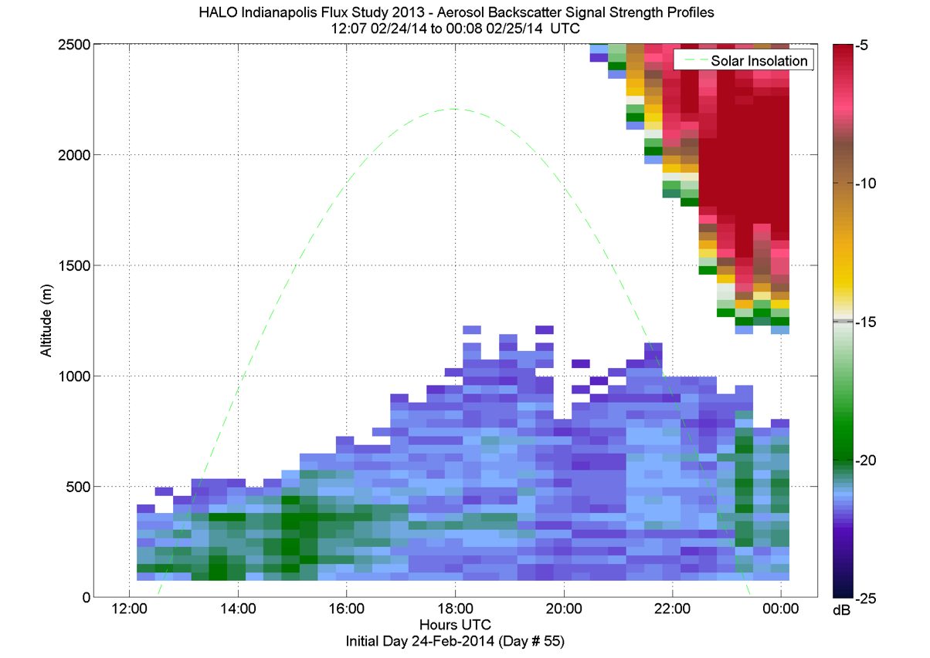

Slide 5
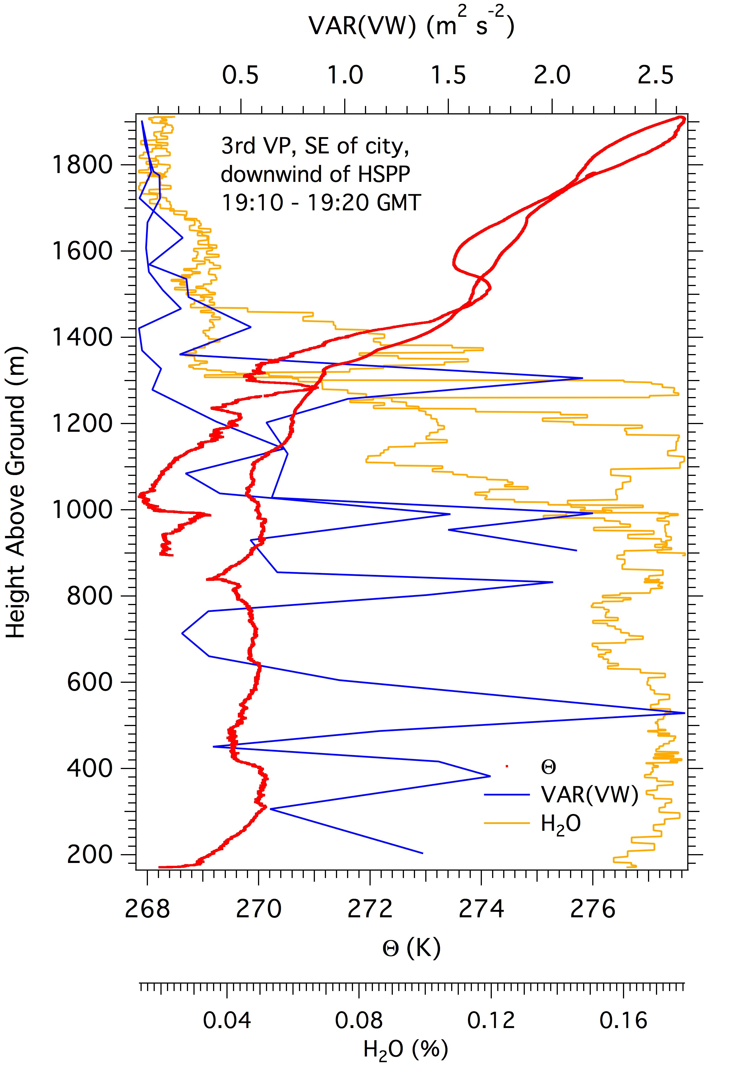

Slide 6
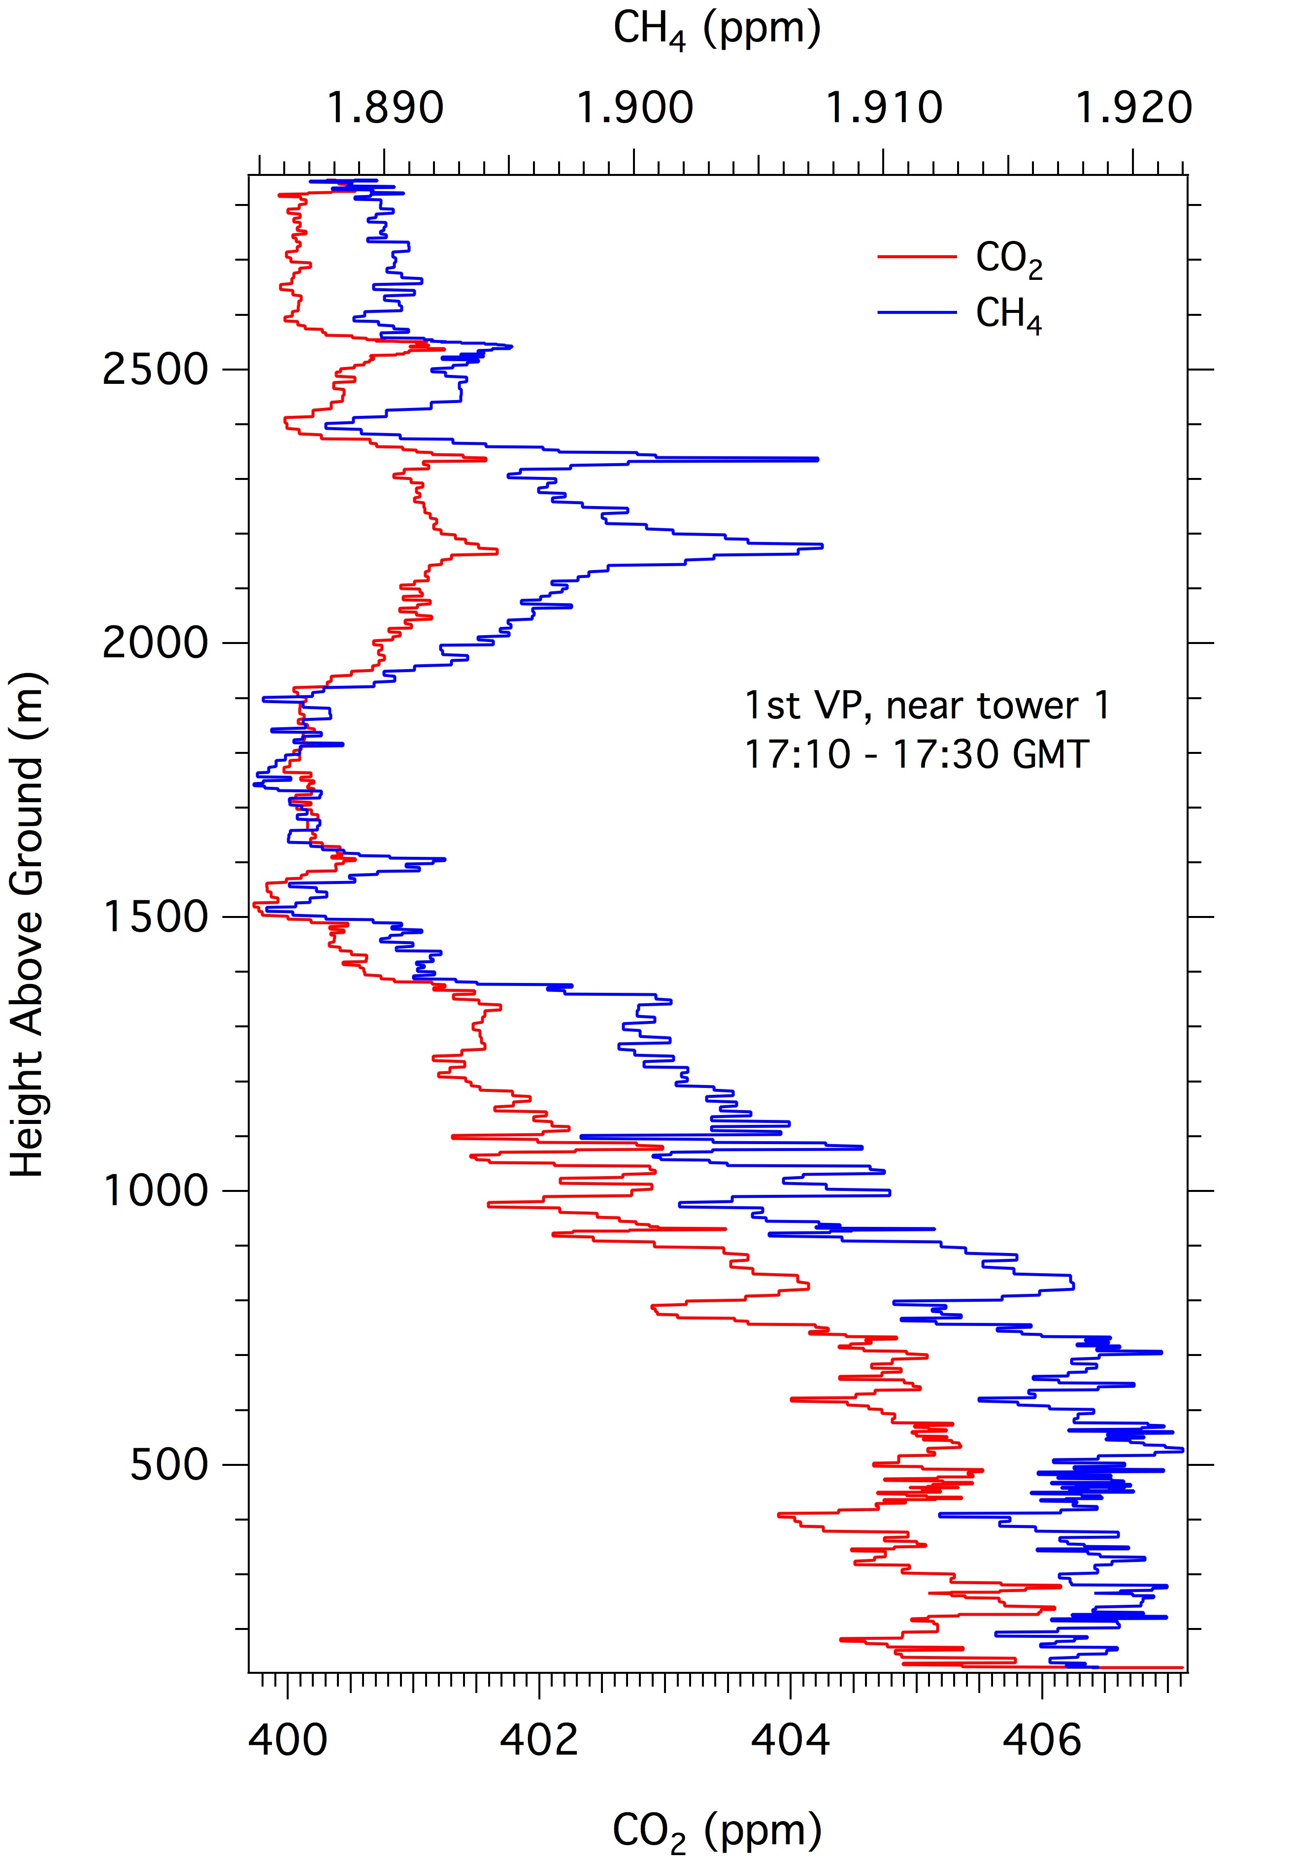
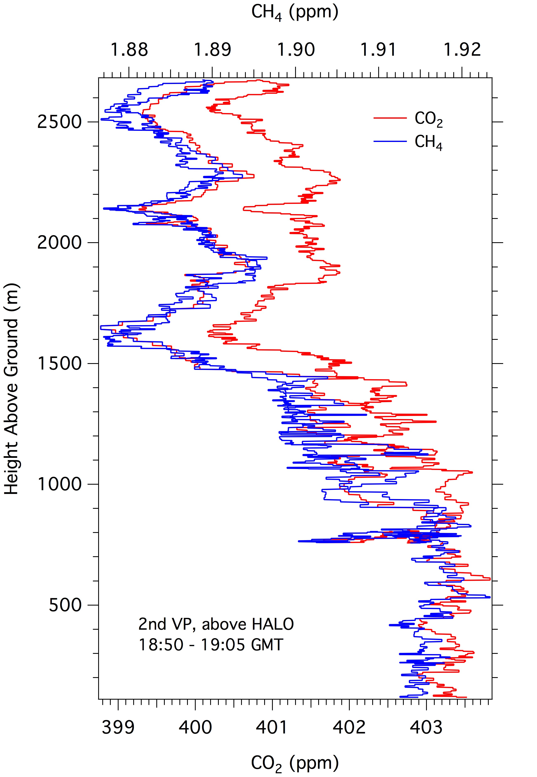

Slide 7
