Slide 1
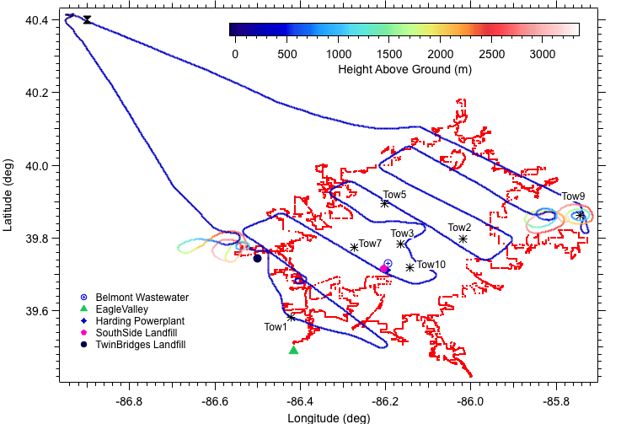
June 6, 2012 Flight Path
6.4 m/s, 54 deg

Slide 2
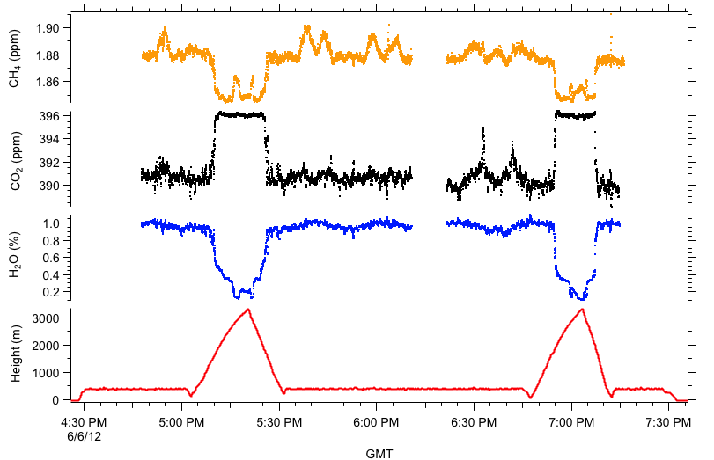
Time Series Distribution of CO₂, CH₄, H₂O
The Picarro analyzer froze here

Slide 3
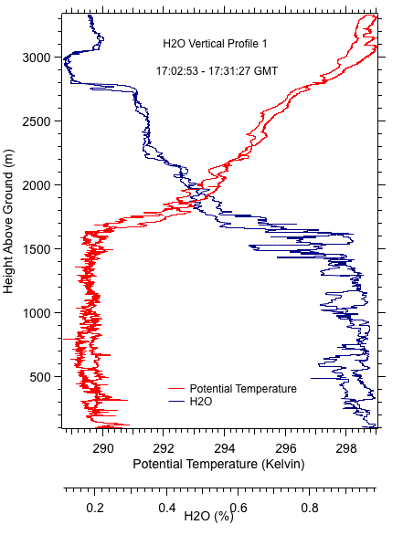
First Vertical Profiles of Potential Temperature and H₂O (~ 1:00 to 1:30 p.m. EDT)

Slide 4
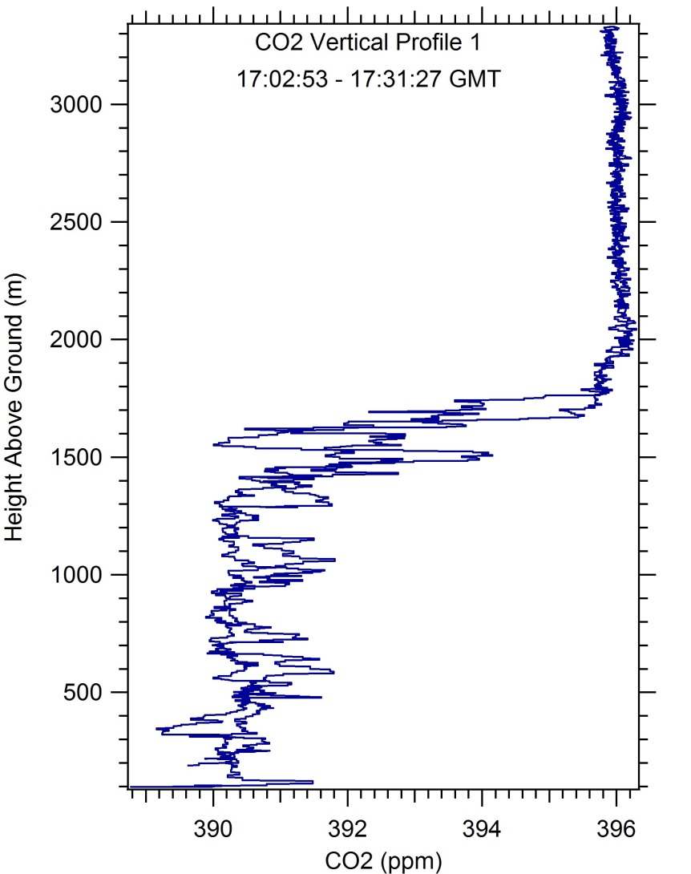
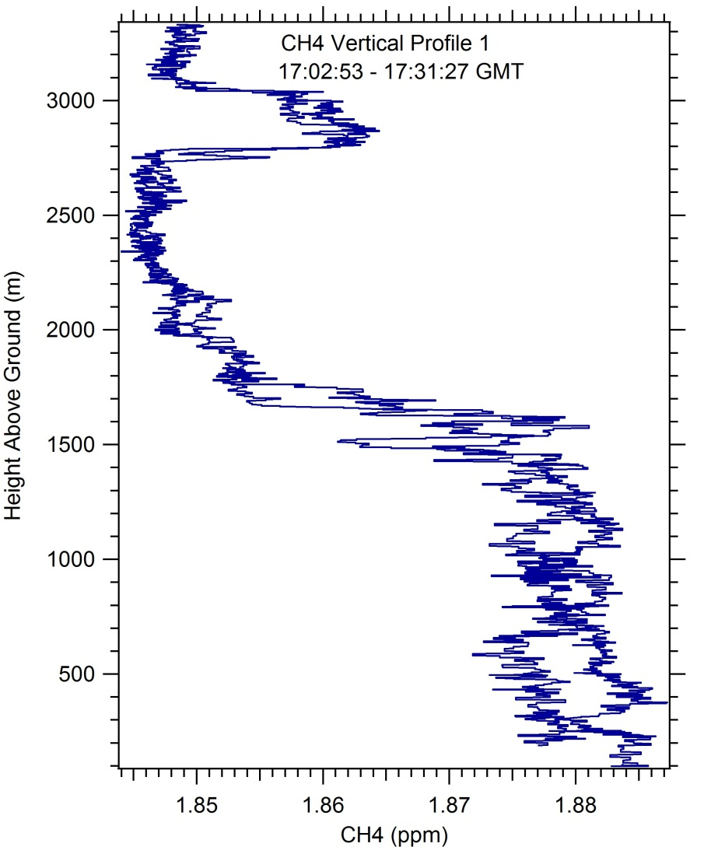
First Vertical Profiles of CO₂ and CH₄ (~ 1:00 to 1:30 p.m. EDT)

Slide 5
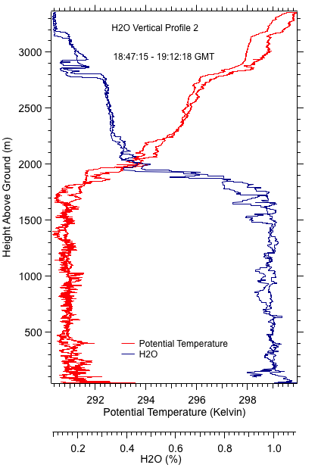
Second Vertical Profiles of Potential Temperature and H₂O (~ 2:45 to 3:15 PM EDT)

Slide 6
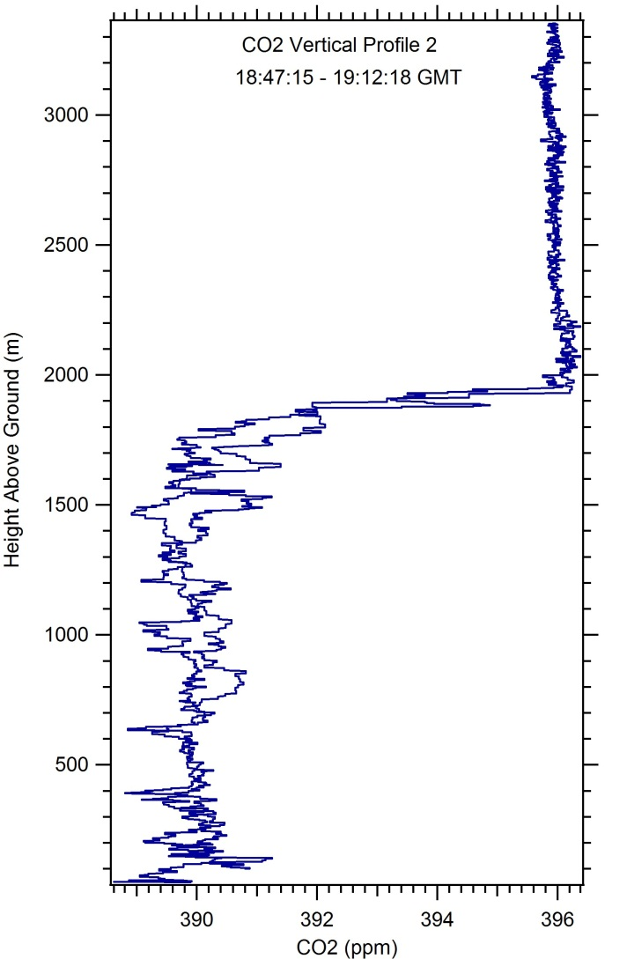
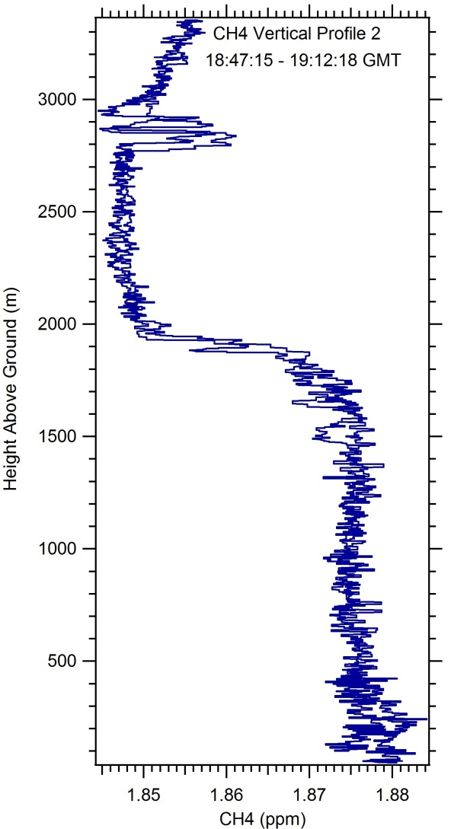
Second Vertical Profiles of CO₂ and CH₄ (~ 2:45 to 3:15 p.m. EDT)

Slide 7
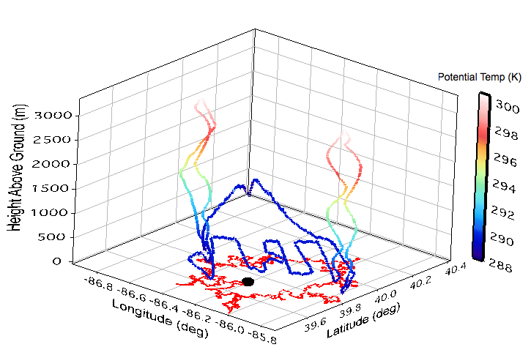
3D distribution of Potential Temperature

Slide 8
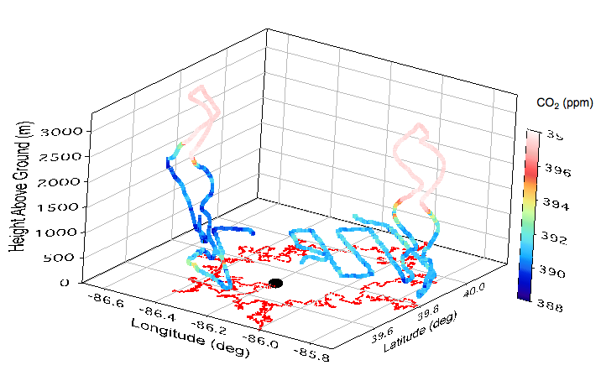
3D distribution of CO₂ (black dot is Harding St. Power Plant)

Slide 9
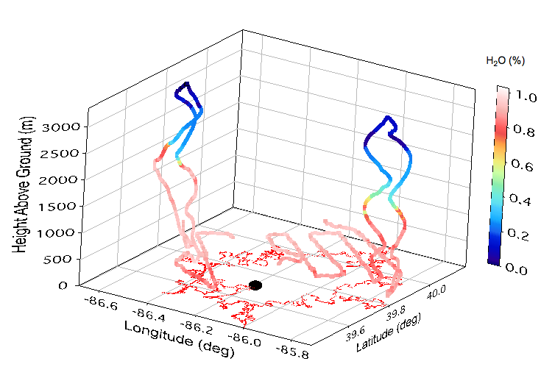
3D distribution of H₂O

Slide 10
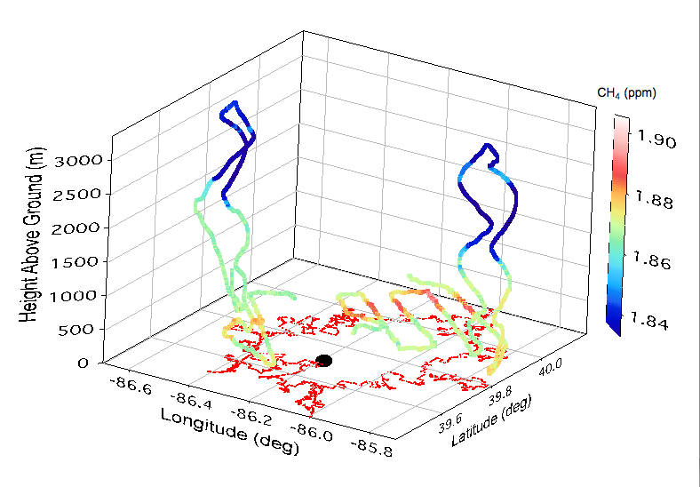
3D distribution of CH₄

Slide 11
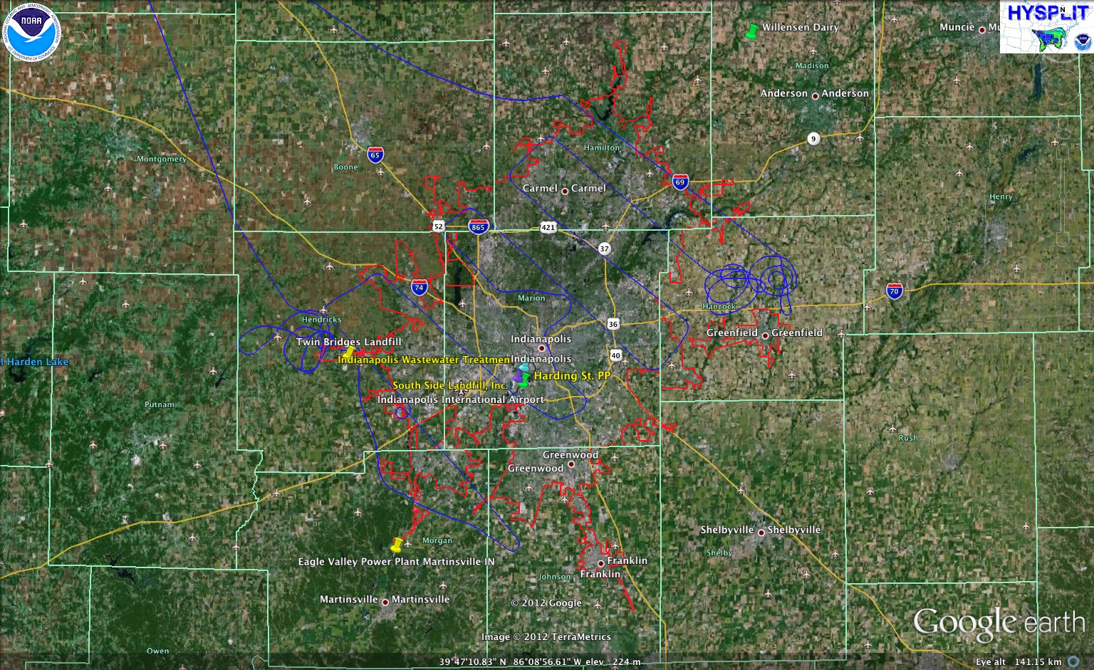
Flight Path in Google Earth

Slide 12
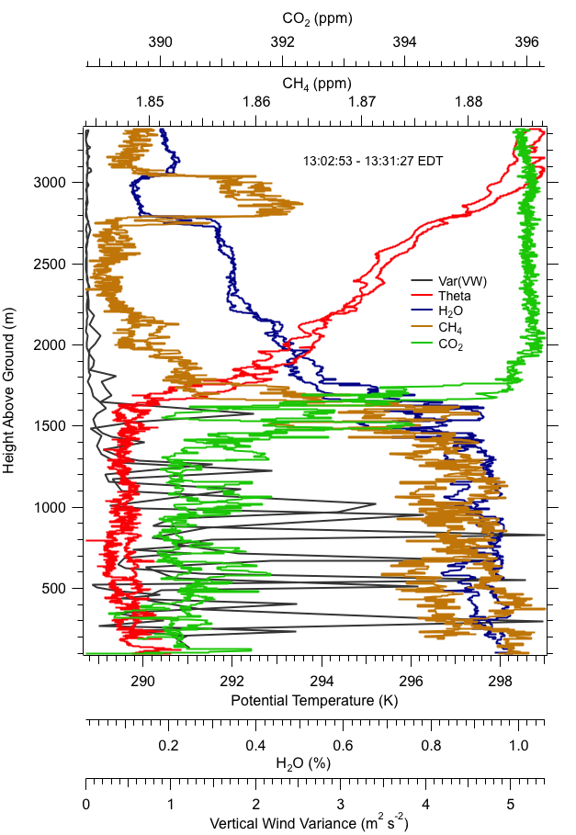
June 6, 2012 First VP

Slide 13
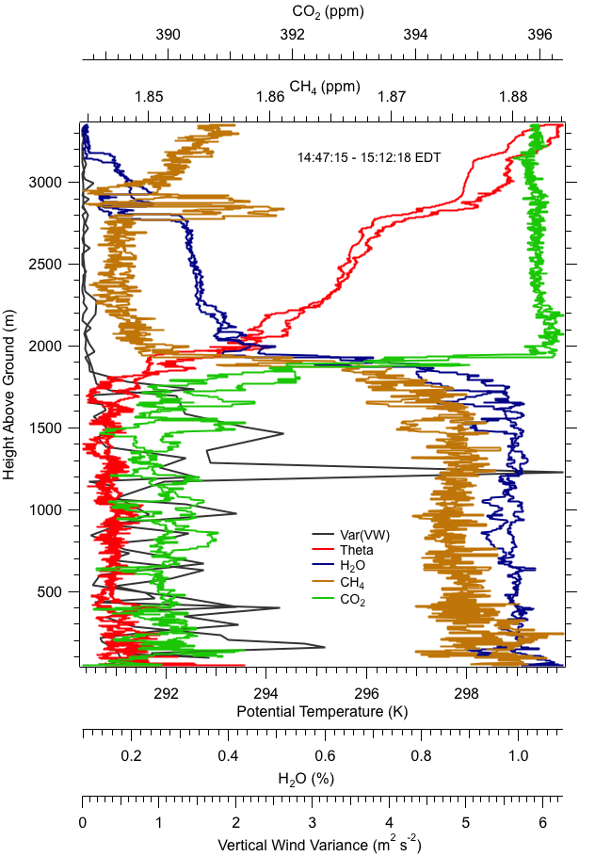
June 6, 2012 Second VP

